Slide 1

CAPSULE NETWORK AS A DISCRIMINATOR AND GENERATOR IN GENERATIVE ADVERSIAL NETWORKS
Amar Shrestha
Swatantra Kafle
05/09/2018

Slide 2
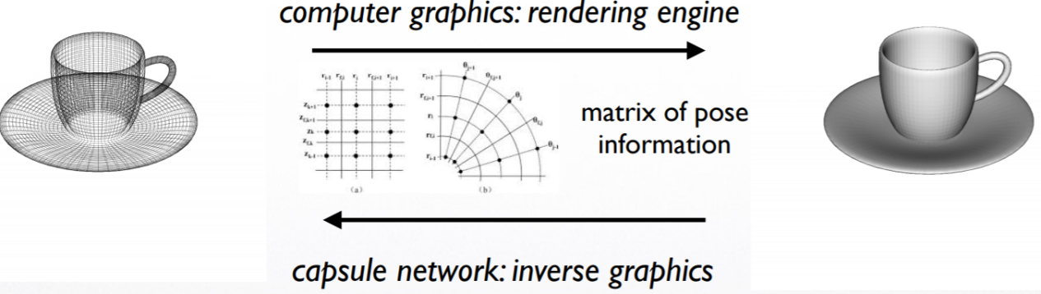
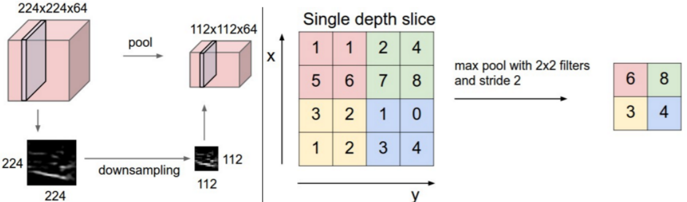
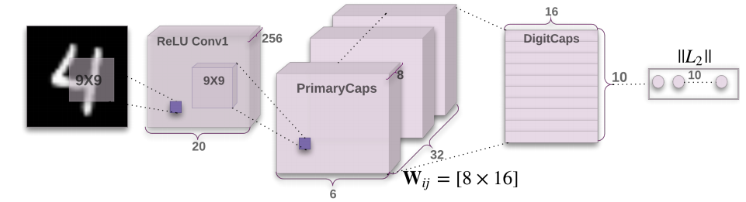
CAPSULE NETWORK
Convnets
Crude translation invariance
No explicit pose (orientation) information
Minimal spatial hierarchies between simple and complex objects.
Capsule Network
Capsule represents feature in terms of a vector: magnitude: probability of presence, direction: instantiation parameters
Invariant to affine transformations (equivariant)
Routing-by-agreement replaces pooling layer to maintain spatial hierarchies
CapsNet Architecture (Sabour et.al, 2017)

Slide 3
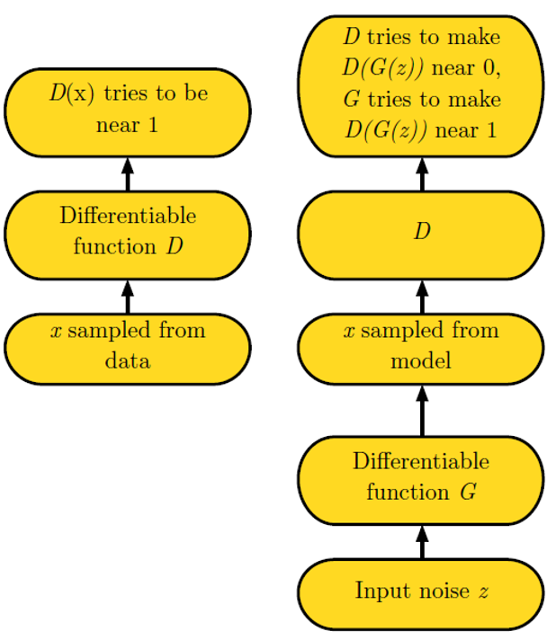
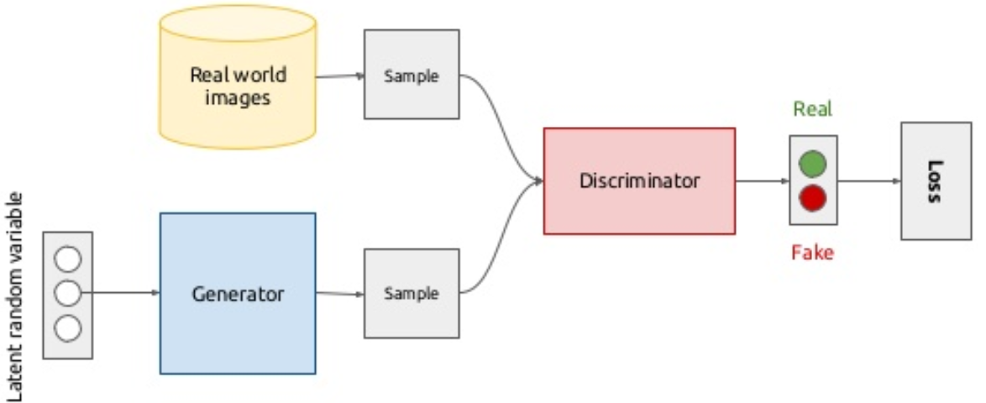
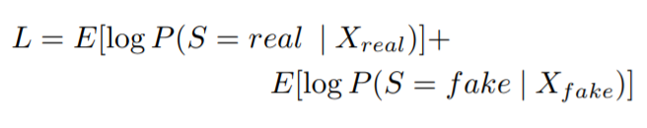
GENERATIVE ADVERSARIAL NETWORKS (GAN)
GAN architecture (Goodfellow et.al, 2014)
MinMax game

Slide 4
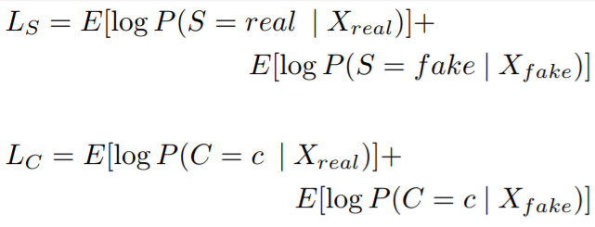
Auxiliary Classifier GAN
Loss_{S}
*
Loss_{C}
Class
Embedding
Label

Slide 5
GAN tricks
Normalize the inputs between -1 and 1
Avoid Sparse Gradients: ReLU, MaxPool
Use Soft and Noisy Labels
Pre-train the discriminator

Slide 6
Project Goals: CAPSNET in GAN
CAPSNET as a discriminator
CAPSNET as a generator
CAPSNET as a generator and discriminator
Application/Validation
MNIST, CIFAR10, Semi-supervised learning GAN [3]

Slide 7
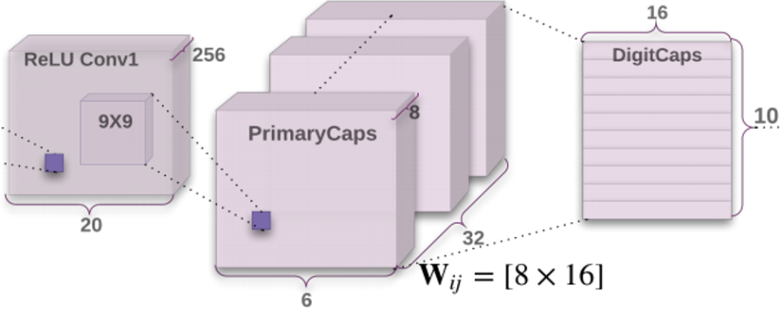
Capsule Network as the discriminator
Discriminator
Loss_{S}
*
Convolutional
layers
Loss_{C}
Class
Embedding
Label

Slide 8
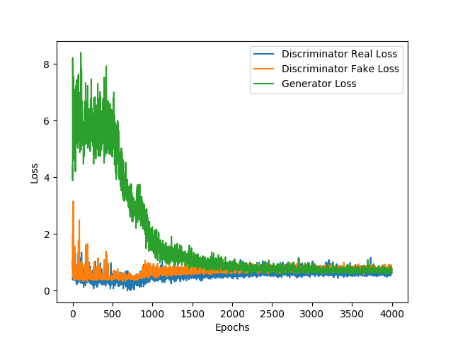
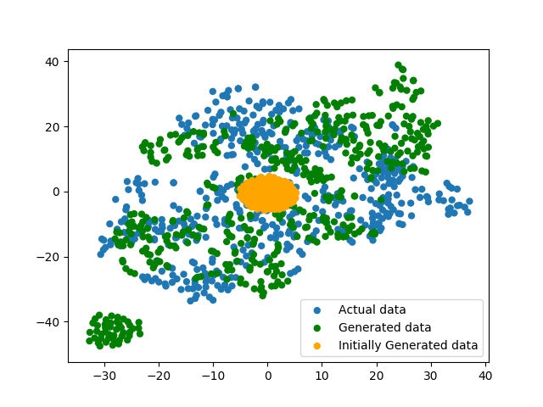
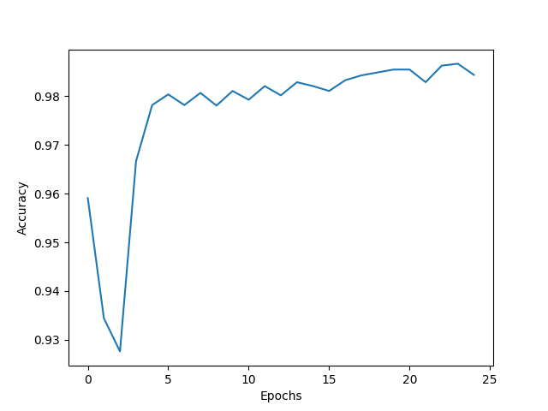
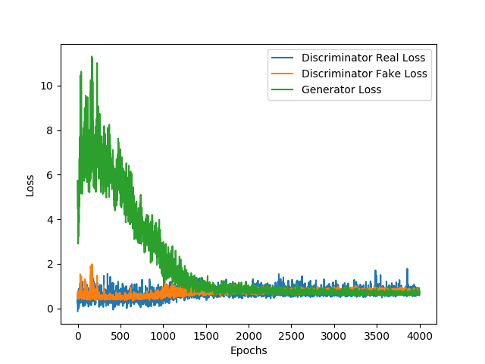
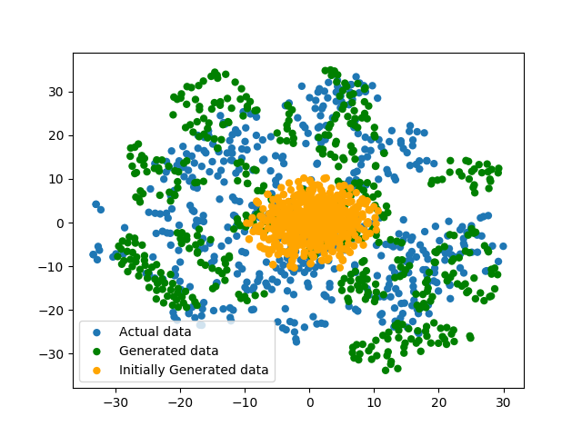
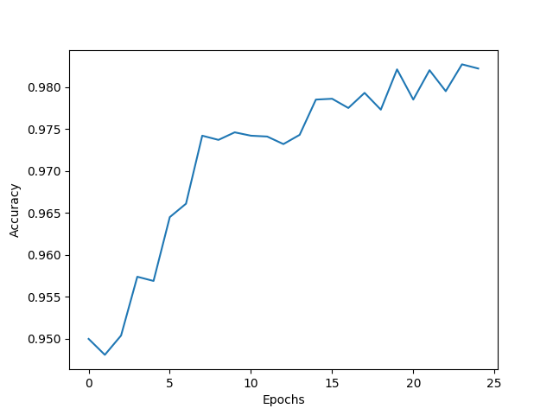
Capsule Network as the discriminator: Results(MNIST)
Capsule Network
Convolutional GAN

Slide 9
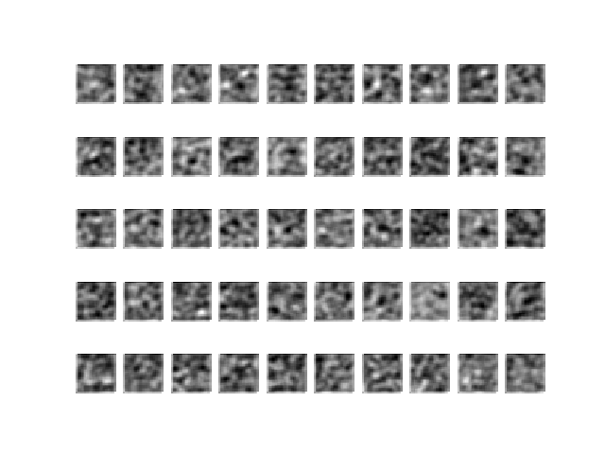
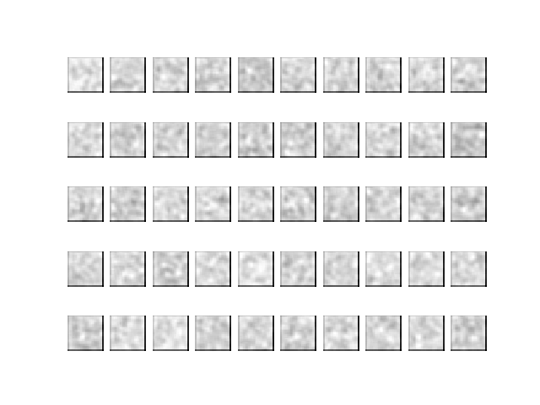
Generated Images: (MNIST)
Capsule Network
Convolutional GAN

Slide 10
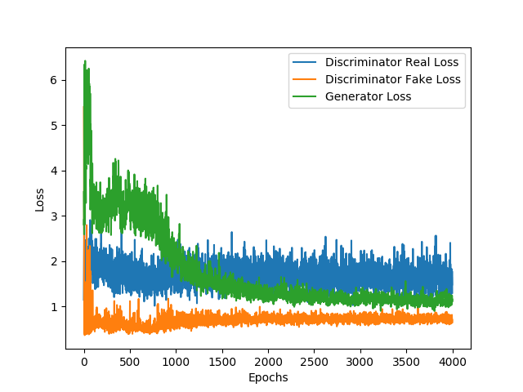
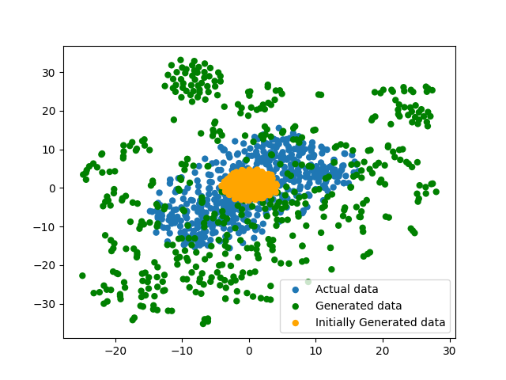
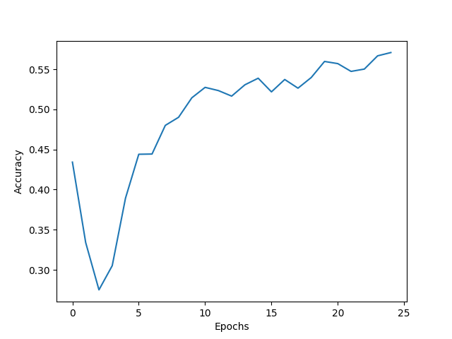
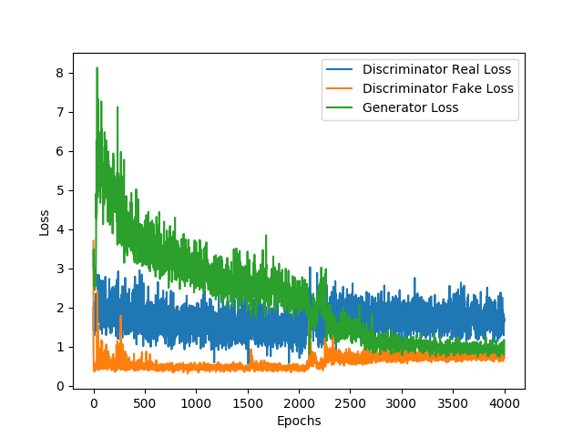
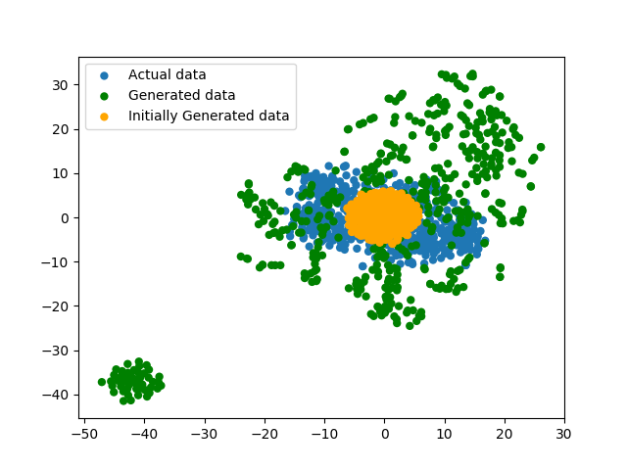
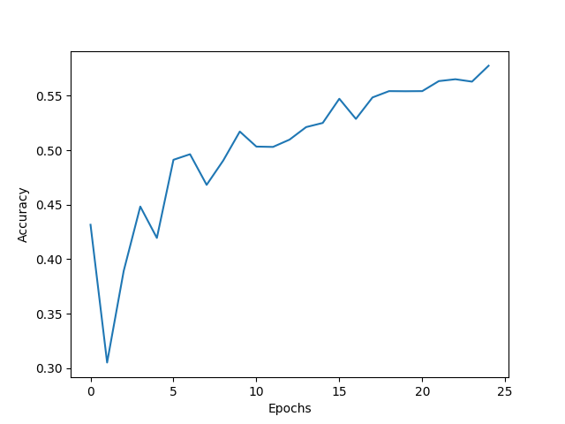
Capsule Network as the discriminator: Results(CIFAR10)
Capsule Network
Convolutional GAN

Slide 11
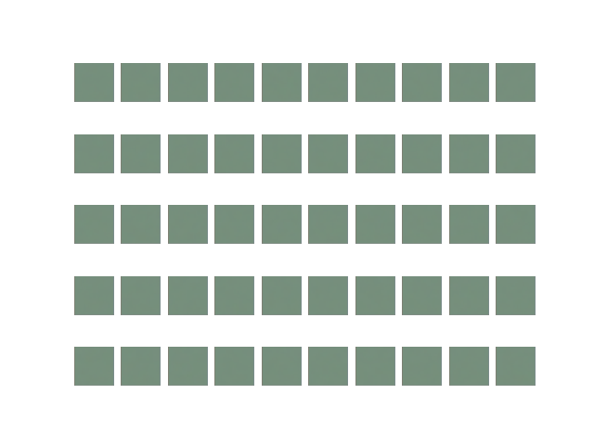
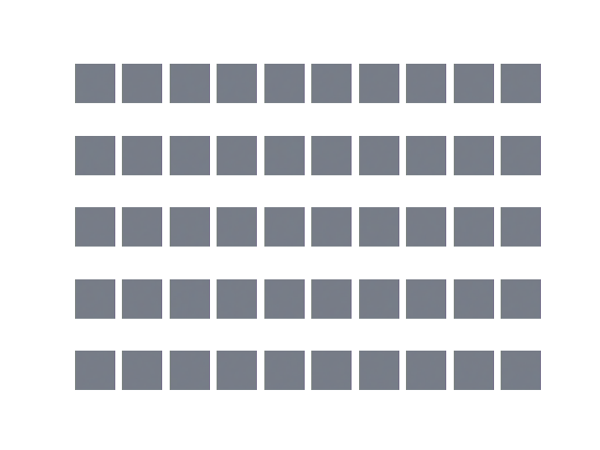
Generated Images: (CIFAR10)
Capsule Network
Convolutional GAN

Slide 12
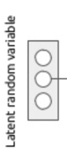
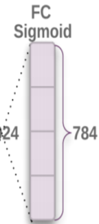

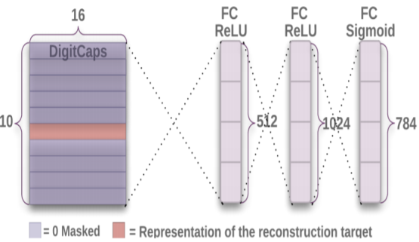
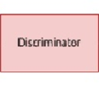
Capsule Network as the Generator and Convolutional NN as discriminator
Generator
Discriminator
(Convolutional NN)
Loss_{S}
*
Convolutional
layers
Loss_{C}
Class
Embedding
Label

Slide 13
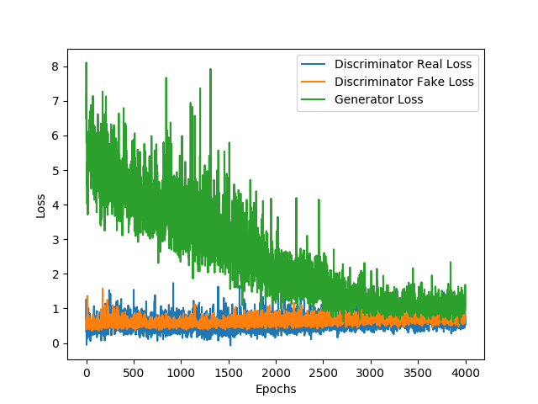
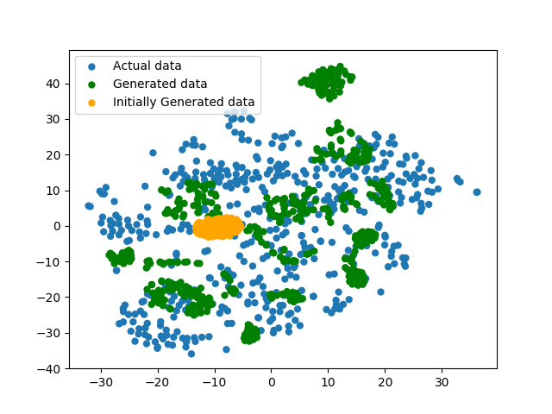
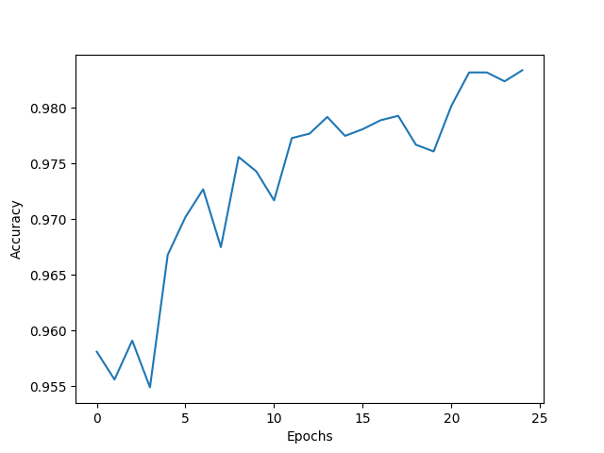
Capsule Network as the generator: Results(MNIST)
Capsule Network
Convolutional GAN

Slide 14
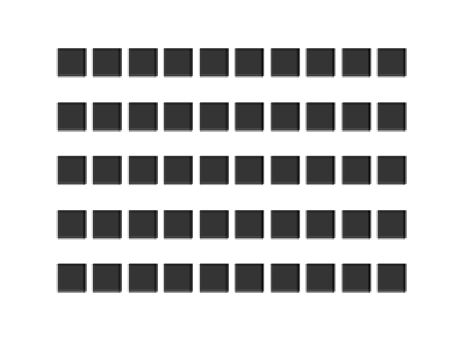
Generated Images: (MNIST)
Capsule Network
Convolutional GAN

Slide 15
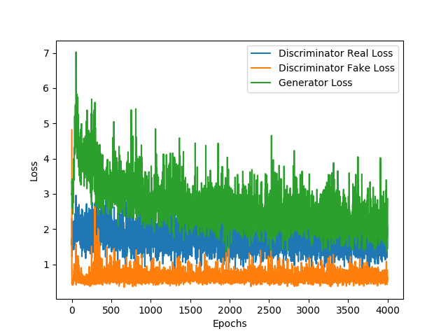
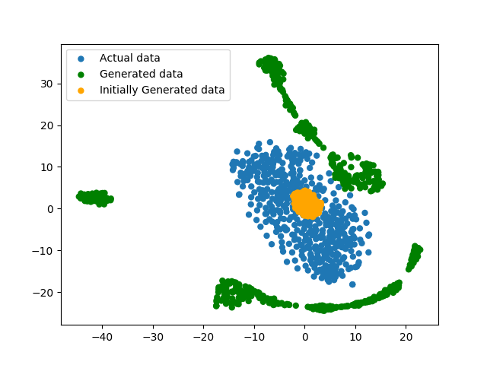
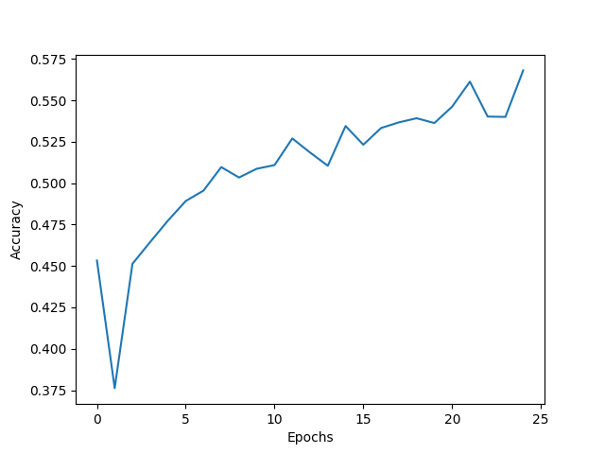
Capsule Network as the generator: Results(CIFAR10)
Capsule Network
Convolutional GAN

Slide 16
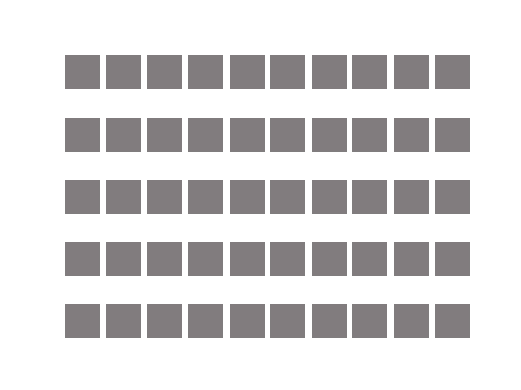
Generated Images: (CIFAR10)
Capsule Network
Convolutional GAN

Slide 17

Capsule Network as the discriminator and the generator
Discriminator
Generator
Loss_{S}
*
Convolutional
layers
Loss_{C}
Class
Embedding
Label

Slide 18
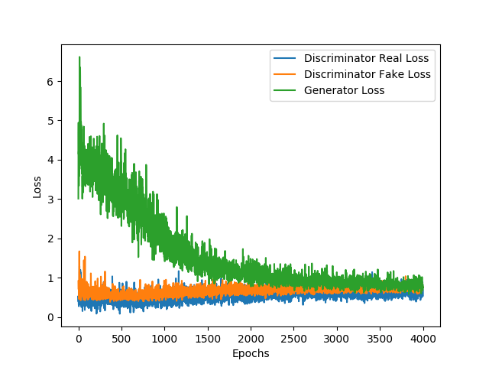
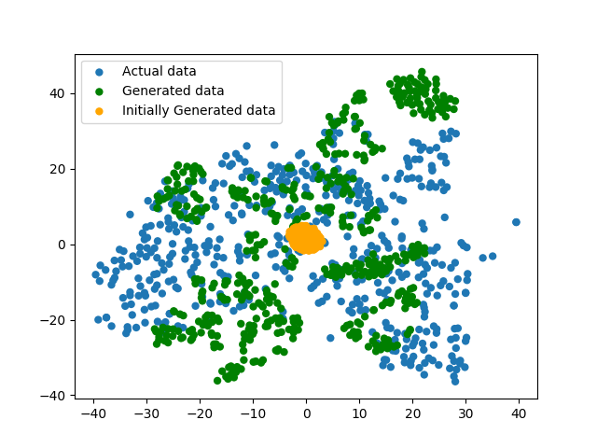
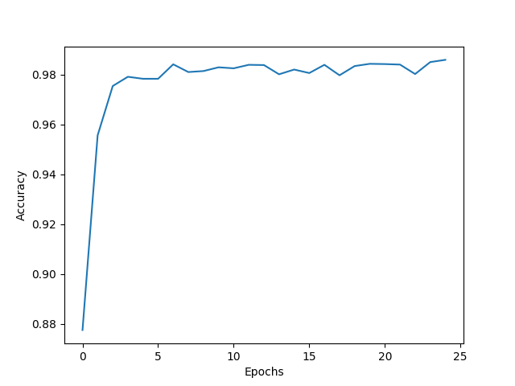
Capsule Network as the discriminator and the generator: Results(MNIST)
Capsule Network
Convolutional GAN

Slide 19
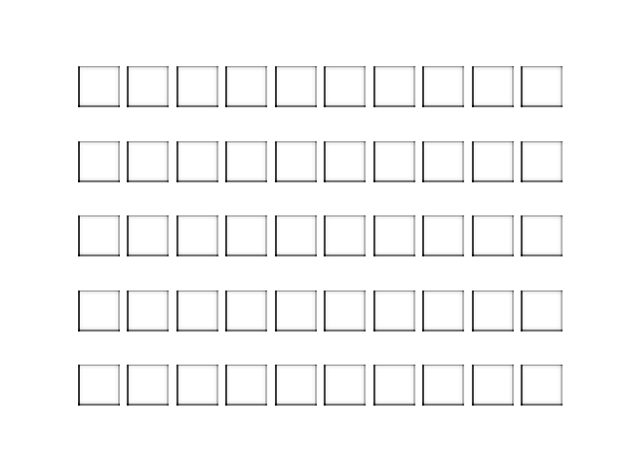
Generated Images: (MNIST)
Capsule Network
Convolutional GAN

Slide 20
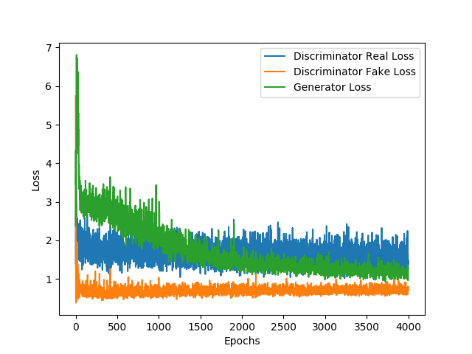
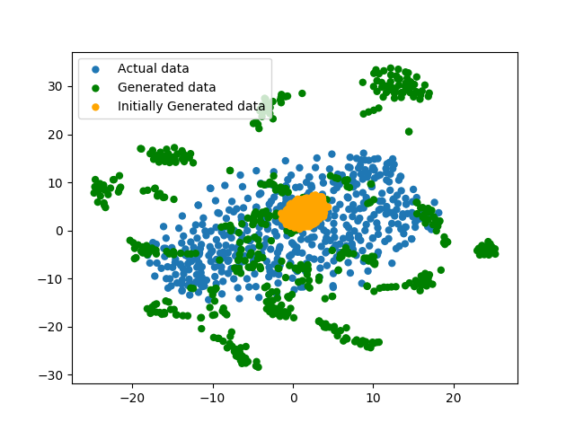
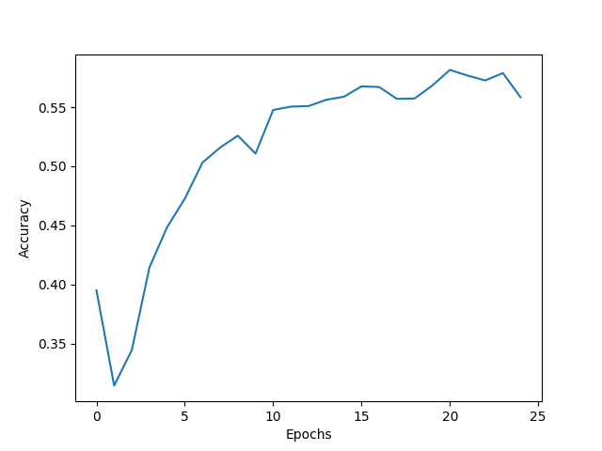
Capsule Network as the discriminator and the generator: Results(CIFAR10)
Capsule Network
Convolutional GAN

Slide 21
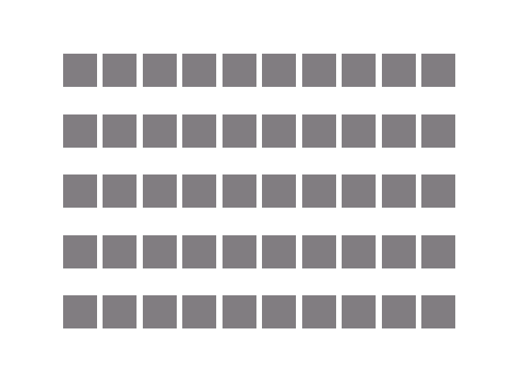
Generated Images: (CIFAR10)
Capsule Network
Convolutional GAN

Slide 22
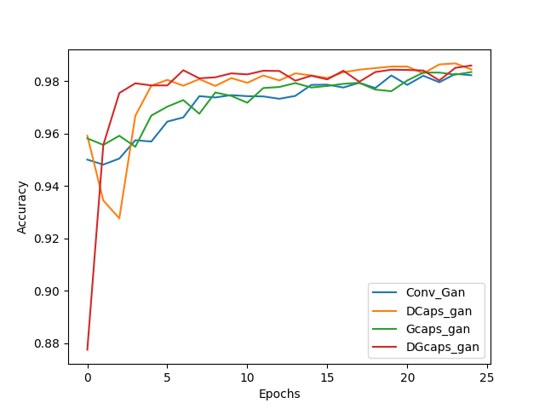
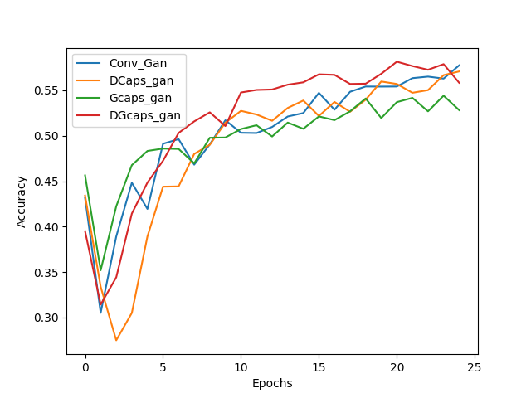
Results:
MNIST
CIFAR10

Slide 23
References
Sabour, Sara, Nicholas Frosst, and Geoffrey E. Hinton. "Dynamic routing between capsules." Advances in Neural Information Processing Systems. 2017.
Goodfellow, Ian, et al. "Generative adversarial nets." Advances in neural information processing systems. 2014.
Odena, Augustus. "Semi-supervised learning with generative adversarial networks." arXiv preprint arXiv:1606.01583 (2016).
Im, Daniel Jiwoong, et al. "Generative Adversarial Metric." (2016).

